Slide 1
PHP
+
Framework
+
MVC

Slide 2
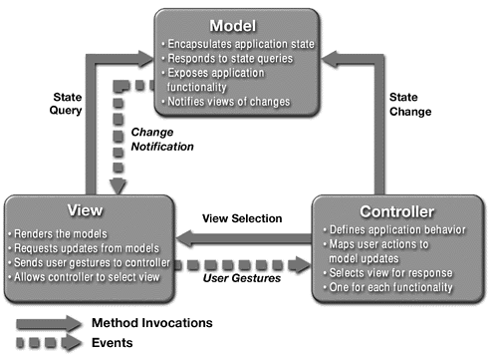

Slide 3
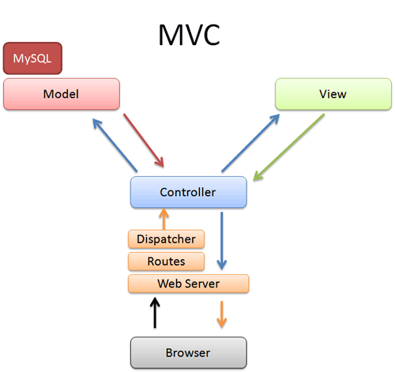

Slide 4
What
is
Framework?

Slide 5
Common code - Generic functionality
Extensible - Specific functionality
Unlike library – Flow Dictated by Framework

Slide 6
Reusable Design- May include:
Support programs
Code libraries
Tools to develop and glue different components

Slide 7
Why
a
Framework?

Slide 8
I am lazy enough to write long codes,
NAAAH...

Slide 9
Technical Aspects:
Proven Architecture
Efficient (Code Re-usability)
Scalable
Extensible
Modularity

Slide 10
Developer Aspects:
Easier maintenance
Shorter development times.
Flexible and less error-prone

Slide 11
Focus => Specialized Functionality
NOT
Architecture
Common Tools
Work Flow

Slide 12
How
to choose
Framework?

Slide 13
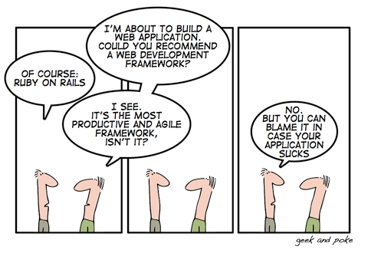

Slide 14
Ofcourse,
NOT

Slide 15
Technical Aspects:
Types of application, Types of framework
Technical features of the framework
Ease of development
Ease of testing
Tool support

Slide 16
Viability Aspects:
Frequent release
Future enhancement
Maturity – real life usage cases
Proven market place?
Production Environments?

Slide 17
So, which one?

Slide 18
The one which answers most of the above questions.

Slide 19
PHP
+
Framework
+
MVC
CakePHP

Slide 20
Free Open Source
Rapid Application Development
Active Community
Compatibility with PHP4 and PHP5
Project Age - 5yrs

Slide 21
MVC
Scaffolding
Validation
Data Sanitation
ACL
Components
Helpers
Security
Session
Caching

Slide 22
Easy Installation – 2 Mins
Easy Debugging
Integrated Unit Testing

